Slide 1
Module -2
Searching and its applications
Types of searching
Linear / Sequential / Exhaustive searching
Binary Searching (Divide and Conquer)

Slide 2
Example : Finding a maximum element in an array
Algo Max-array(A,n)
{
Max = A[1];
for i = 2 to n do
if ( A[i] > Max ) then Max = A[i];
return Max;
}

Slide 3
Iterative :
Fact(n)
{
for i = 1 to n
fact = fact * i;
return fact;
}
Here the factorial is calculated as 1 × 2 × 3 × . . . × n

Slide 4
Recursive :
Fact(n)
{
if n = 1
return 1;
else
return n * fact(n-1);
}
Here the factorial is calculated as n × (n − 1) × . . . × 1.

Slide 5

Searching

Slide 6

Searching

Slide 7

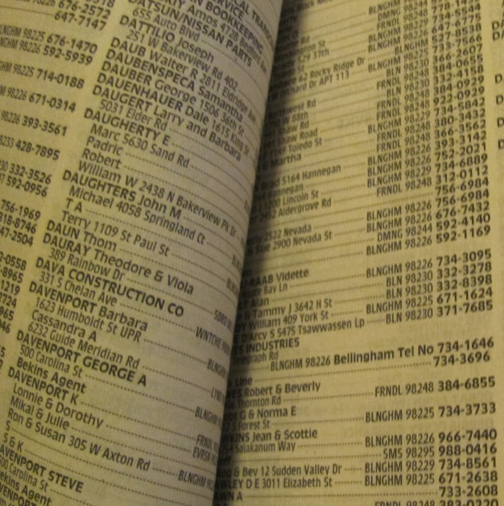
Searching

Slide 8
Linear Search
Linear search. Given value and unsorted array a[], find index i such that a[i] = value, or report that no such index exists.
Invariant. Algorithm maintains a[i] = value
else no such index exists.
Ex. Linear search for 33. int a[15];
6
13
14
25
33
43
51
53
64
72
84
93
95
96
97
0
1
2
3
4
5
6
7
8
9
10
11
12
13
14

Slide 9
Linear Search
Linear search. Given value and unsorted array a[], find index i such that a[i] = value, or report that no such index exists.
Invariant. Algorithm maintains a[i] = value
else on such index exists.
Ex. Linear search for 33.
6
13
14
25
33
43
51
53
64
72
84
93
95
96
97
0
1
2
3
4
5
6
7
8
9
10
11
12
13
14

Slide 10
Linear Search
Linear search. Given value and unsorted array a[], find index i such that a[i] = value, or report that no such index exists.
Invariant. Algorithm maintains a[i] = value
else on such index exists.
Ex. Linear search for 33.
6
13
14
25
33
43
51
53
64
72
84
93
95
96
97
0
1
2
3
4
5
6
7
8
9
10
11
12
13
14

Slide 11
Linear Search
Linear search. Given value and unsorted array a[], find index i such that a[i] = value, or report that no such index exists.
Invariant. Algorithm maintains a[i] = value
else on such index exists.
Ex. Linear search for 33.
6
13
14
25
33
43
51
53
64
72
84
93
95
96
97
0
1
2
3
4
5
6
7
8
9
10
11
12
13
14

Slide 12
Linear Search
Linear search. Given value and unsorted array a[], find index i such that a[i] = value, or report that no such index exists.
Invariant. Algorithm maintains a[i] = value
else on such index exists.
Ex. Linear search for 33.
6
13
14
25
33
43
51
53
64
72
84
93
95
96
97
0
1
2
3
4
5
6
7
8
9
10
11
12
13
14

Slide 13
Algorithm
L
I
N
E
A
R
S
E
A
R
C
H
I
N
G
int sequential_search( int a[], int n, int key)
Read array elements n, a[ ] = n
Read element to be searched ‘key’ =1
int i;
for(i=0; i< n; i++) =n+1
{
if ( a[i] == key ) =n
{
print “ element ‘x’ is found” =1
return i; =1
else
return -1; =1
}
}

Slide 14
Time Complexity
Average comparisons = number of comparisons upto oth position + number of comparisons upto 1st position +………+ number of comparisons upto nth position
=(1+2+3+….+n)/n
= n(n+1)/n.2
=1/2(n+1)

Slide 15
#include<stdio.h>
main()
{
int i,x,a[20],n;
printf("Enter the number of elements")
printf("Enter the array elements“)
for(i=0;i<n;i++)
scanf(“%d”,&a[i]);
printf("Enter the element to be searched:")
scanf(“%d”,&x);
i=0
while(i<n):
if(a[i]==x):
print("Element",x,"is found in",i+1,"th position")
exit(0)
else
i=i+1
print("Element",%d,"is not found“,x)

Slide 16
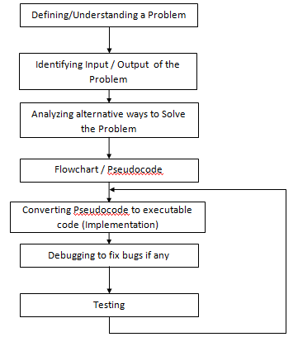
Problem Solving Steps

Slide 17
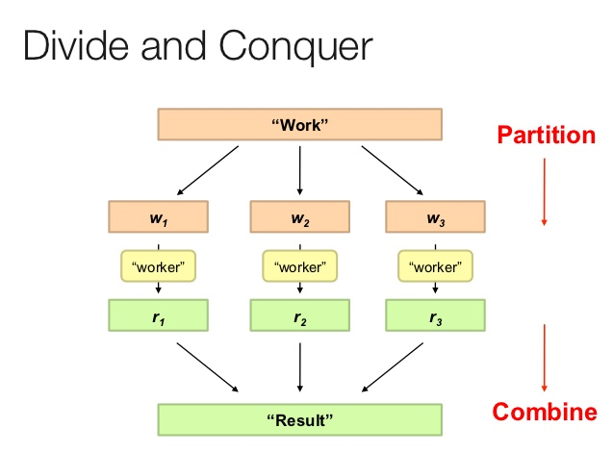

Slide 18
Binary Search
Binary search. Given value and sorted array a[], find index i such that a[i] = value, or report that no such index exists.
Invariant. Algorithm maintains a[lo] ≤ value ≤ a[hi].
Ex. Binary search for 33.
6
13
14
25
33
43
51
53
64
72
84
93
95
96
97
0
1
2
3
4
5
6
7
8
9
10
11
12
13
14
lo
hi

Slide 19
Binary Search
Binary search. Given value and sorted array a[], find index i such that a[i] = value, or report that no such index exists.
Invariant. Algorithm maintains a[lo] ≤ value ≤ a[hi].
Ex. Binary search for 33.
6
13
14
25
33
43
51
53
64
72
84
93
95
96
97
0
1
2
3
4
5
6
7
8
9
10
11
12
13
14
lo
mid
hi

Slide 20
Binary Search
Binary search. Given value and sorted array a[], find index i such that a[i] = value, or report that no such index exists.
Invariant. Algorithm maintains a[lo] ≤ value ≤ a[hi].
Ex. Binary search for 33.
6
13
14
25
33
43
51
53
64
72
84
93
95
96
97
0
1
2
3
4
5
6
7
8
9
10
11
12
13
14
lo
hi

Slide 21
Binary Search
Binary search. Given value and sorted array a[], find index i such that a[i] = value, or report that no such index exists.
Invariant. Algorithm maintains a[lo] ≤ value ≤ a[hi].
Ex. Binary search for 33.
6
13
14
25
33
43
51
53
64
72
84
93
95
96
97
0
1
2
3
4
5
6
7
8
9
10
11
12
13
14
lo
mid
hi

Slide 22
Binary Search
Binary search. Given value and sorted array a[], find index i such that a[i] = value, or report that no such index exists.
Invariant. Algorithm maintains a[lo] ≤ value ≤ a[hi].
Ex. Binary search for 33.
6
13
14
25
33
43
51
53
64
72
84
93
95
96
97
0
1
2
3
4
5
6
7
8
9
10
11
12
13
14
lo
hi

Slide 23
Binary Search
Binary search. Given value and sorted array a[], find index i such that a[i] = value, or report that no such index exists.
Invariant. Algorithm maintains a[lo] ≤ value ≤ a[hi].
Ex. Binary search for 33.
6
13
14
25
33
43
51
53
64
72
84
93
95
96
97
0
1
2
3
4
5
6
7
8
9
10
11
12
13
14
lo
mid
hi

Slide 24
Binary Search
Binary search. Given value and sorted array a[], find index i such that a[i] = value, or report that no such index exists.
Invariant. Algorithm maintains a[lo] ≤ value ≤ a[hi].
Ex. Binary search for 33.
6
13
14
25
33
43
51
53
64
72
84
93
95
96
97
0
1
2
3
4
5
6
7
8
9
10
11
12
13
14
lo hi

Slide 25
Binary Search
Binary search. Given value and sorted array a[], find index i such that a[i] = value, or report that no such index exists.
Invariant. Algorithm maintains a[lo] ≤ value ≤ a[hi].
Ex. Binary search for 33.
6
13
14
25
33
43
51
53
64
72
84
93
95
96
97
0
1
2
3
4
5
6
7
8
9
10
11
12
13
14
lo hi mid

Slide 26
Binary Search
Binary search. Given value and sorted array a[], find index i such that a[i] = value, or report that no such index exists.
Invariant. Algorithm maintains a[lo] ≤ value ≤ a[hi].
Ex. Binary search for 33.
6
13
14
25
33
43
51
53
64
72
84
93
95
96
97
0
1
2
3
4
5
6
7
8
9
10
11
12
13
14
lo hi mid

Slide 27
Algorithm
int binary_search (int a[], int n, int key)
Read array elements n, a[ ]
Read element to be searched ‘x’
int low=0; high=n-1;
found=0;
while ( low<=high && !found) {
mid = (low + high) / 2;
if ( a[mid] == key)
found=1;
else if( key < a[mid])
high = mid – 1;
else
low = mid +1;
}
if (found)
return mid;
Else return -1;
B
I
N
A
R
Y
S
E
A
R
C
H
I
N
G

Slide 28
Time Complexity
An element at index N/2 can be found in 1 comparison
Elements at index N/4 and 3N/4 can be found in 2 comparisons.
Elements at indices N/8, 3N/8, 5N/8 and 7N/8 can be found in 3 comparisons and so on.
Based on this we can conclude that elements that require:
1 comparison = 1
2 comparisons = 2
3 comparisons = 4
x comparisons = 2^{x-1} where x belongs to the range [1, logN] because maximum comparisons = maximum time N can be halved = maximum comparisons to reach 1st element = logN.
So, total comparisons = 1*(elements requiring 1 comparisons) + 2*(elements requiring 2 comparisons) + . . . + logN*(elements requiring logN comparisons) = 1*1 + 2*2 + 3*4 + . . . + logN

Slide 29
y=[1,2,3,4,5,7,8,9,10]
x=int(input("Enter the element to be searched:"))
f=0
l=len(y)-1
while(f<=l):
mid=(f+l)//2
if(y[mid]==x):
print("Element",x,"is found in",mid+1,"th position")
exit(0)
elif(x>y[mid]):
f=mid+1
else:
l=mid-1
print("Element",x,"is not found")

Slide 30
Recursive Algorithm
int binarySearch(int a[], int beg, int end, int val)
{
int mid;
if(end >= beg)
{
mid = (beg + end)/2;
/* if the item to be searched is present at middle */
if(a[mid] == val)
{
return mid+1;
}

Slide 31
/* if the item to be searched is smaller than middle, then it can only be in left subarray */
else if(a[mid] < val)
{
return binarySearch(a, mid+1, end, val);
}
/* if the item to be searched is greater than middle, then it can only be in right subarray */
else
{
return binarySearch(a, beg, mid-1, val);
}
}
return -1;
}

Slide 32
T(n) = c + T(n/2) …..1
T(n/2) = c + T(n/4) …..2
Subs. 2 in 1
T(n) = T(n/4) + 2c ……3
T(n/4) = c + T(n/8) ……4
Subs 4 in 3
T(n) = T(n/8) + 3c
……………..
……………
T(n) = T(n/2^{k}) + kc
Let n= 2^{k}
Take log on both sides
Log₂ n = log 2^{k}
Log₂ n = k log₂ 2
T(n) = T(1) + Log₂ n .C

Slide 33
Linear Search:
Binary Search:
97
64
14
25
33
43
51
53
39
72
84
93
95
96
6
0
1
2
3
4
5
6
7
8
9
10
11
12
13
14
6
13
14
25
33
43
51
53
64
72
84
93
95
96
97
0
1
2
3
4
5
6
7
8
9
10
11
12
13
14
lo
hi

Slide 34
Linear Search
Linear search. Given value and unsorted array a[], find index i such that a[i] = value, or report that no such index exists.
Invariant. Algorithm maintains a[i] = value
else on such index exists.
Ex. Linear search for 33.
6
13
14
25
33
43
51
53
64
72
84
93
95
96
97
0
1
2
3
4
5
6
7
8
9
10
11
12
13
14

Slide 35
Recursive algorithm for sum of N natural numbers
#include<stdio.h>
int sum(int n)
{
if(n<=1)
return n;
else
return n+sum(n-1);
}
int main()
{
int n;
printf("enter the value of n=");
scanf("%d",&n);
printf("sum=%d",dis(n));
return 0;
}

Slide 36
Time Complexity
T(n) = 1, n=1
1+ T(n-1), n>1
T(n) = 1+ T(n-1)
= 1+[1+T(n-2)]
= 2 + T(n-2)
= 3+ T(n-3)
………………………….
…………………………
=(n-1)+T(n-(n-1))
= n-1+1 [ T(1)=1]
T(n) = n

Slide 37
#include<stdio.h>
int fib(int n) {
if (n == 1)
return 0; //First digit in the series is 0
else if (n == 2)
return 1; //Second digit in the series is 1
else
return (fib(n - 1) + fib(n - 2)); //Sum of previous two numbers in the series gives the next number in the series
}
int main() {
int n = 5;
int i;
printf("The fibonacci series is :\n");
for (i = 1; i <= n; i++) {
printf("%d ", fib(i));
}
}

Slide 38
1. There are ‘n’ number of Students in a class. The teacher wants to identify whether a student ‘X’ is present in the class or not using register number. If the student is present print 1 else print 0.
Input format:
Read n #no of elements to be stored in the array
Read s # Reg_No of students.
Read x #Reg_No of the student to be found.
Output format:
Print 1 IF the student is present.
Print 0 IF the student is absent.

Slide 39
2. You are given an array containing ‘n’ integers. You are asked to determine if the list contains two numbers that sum to some arbitrary integer, ‘k’. If such ‘k’ exists print those two numbers which sums to ‘k’ else print 0.
For example, if the list is 8, 4, 1 and 6 and k = 10, the answer is 4 6, because 4+6 = 10.
Input format:
Read n #no of elements to be stored in the array
Read s # elements to be stored in the array
Read k
Output format:
Print the digits which sums to k.
Print 0, if no such k

Slide 40
There is a digital bank locker which can be opened with a five digit security number. This security number should be a palindrome number. There is a box which contains ‘n’ five digit numbers among which only one number is a palindrome number. Write an algorithm to find the security number and open the locker.

